Slide 1

ODOT Policy for Deck/Slab Closure Pours
Sean Meddles, P.E.
Assistant Administrator
ODOT Office of Structural Engineering

Slide 2
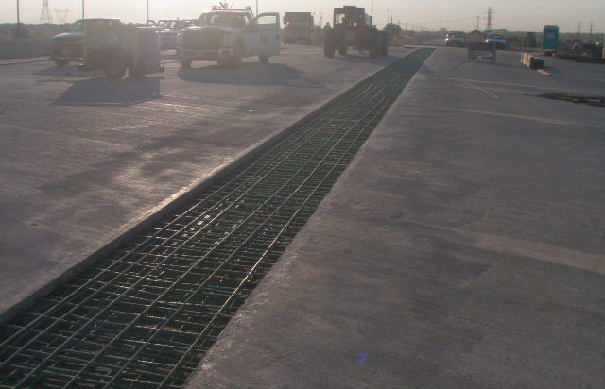
What is ODOT’s Policy?
BDM Section 302.2.9
For all bridge types, except non-composite box beams, where the differential dead load deflection is greater than ¼”, a deck closure pour is required if the bridge is constructed in stages

Slide 3
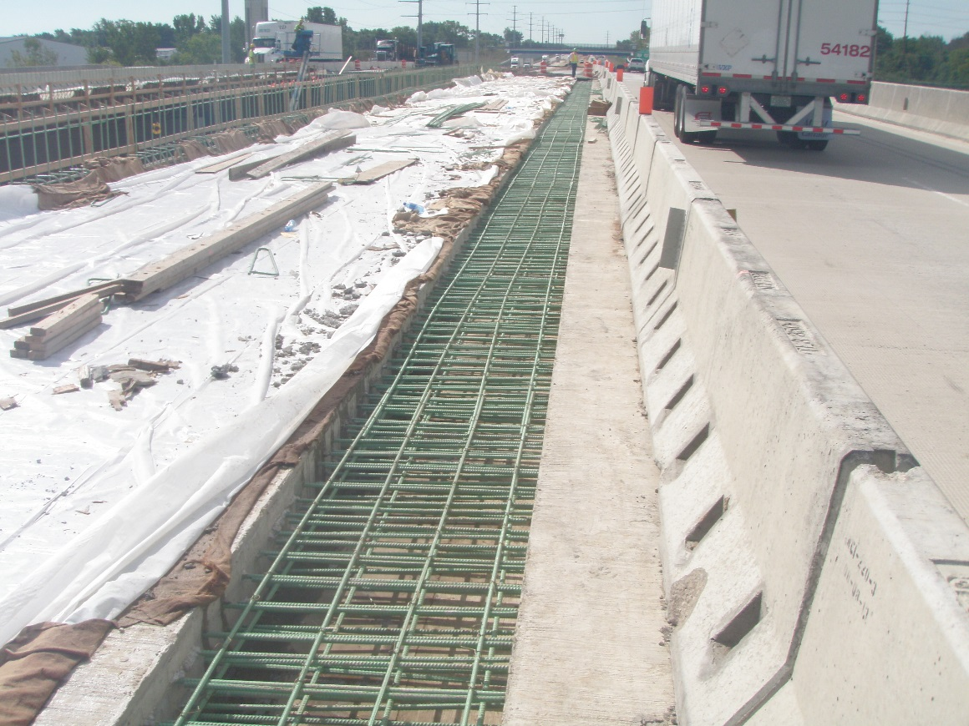
What is ODOT’s Policy?
BDM Section 302.2.9
Closure Pour minimum width = 30”

Slide 4
What is meant by “Differential Dead Load Deflection”?
Differential Dead Load Deflection is the vertical movement of the superstructure between adjacent phases
Differential loading is caused by the placement of the deck concrete

Slide 5
Why Closure Pours?
Allow alignment of reinforcing steel between adjacent phases
Prevent concrete voids & surface irregularities
Prevent opening of construction joints
Decks Vs. Slabs

Slide 6
Alignment of Reinforcing Steel

Slide 7

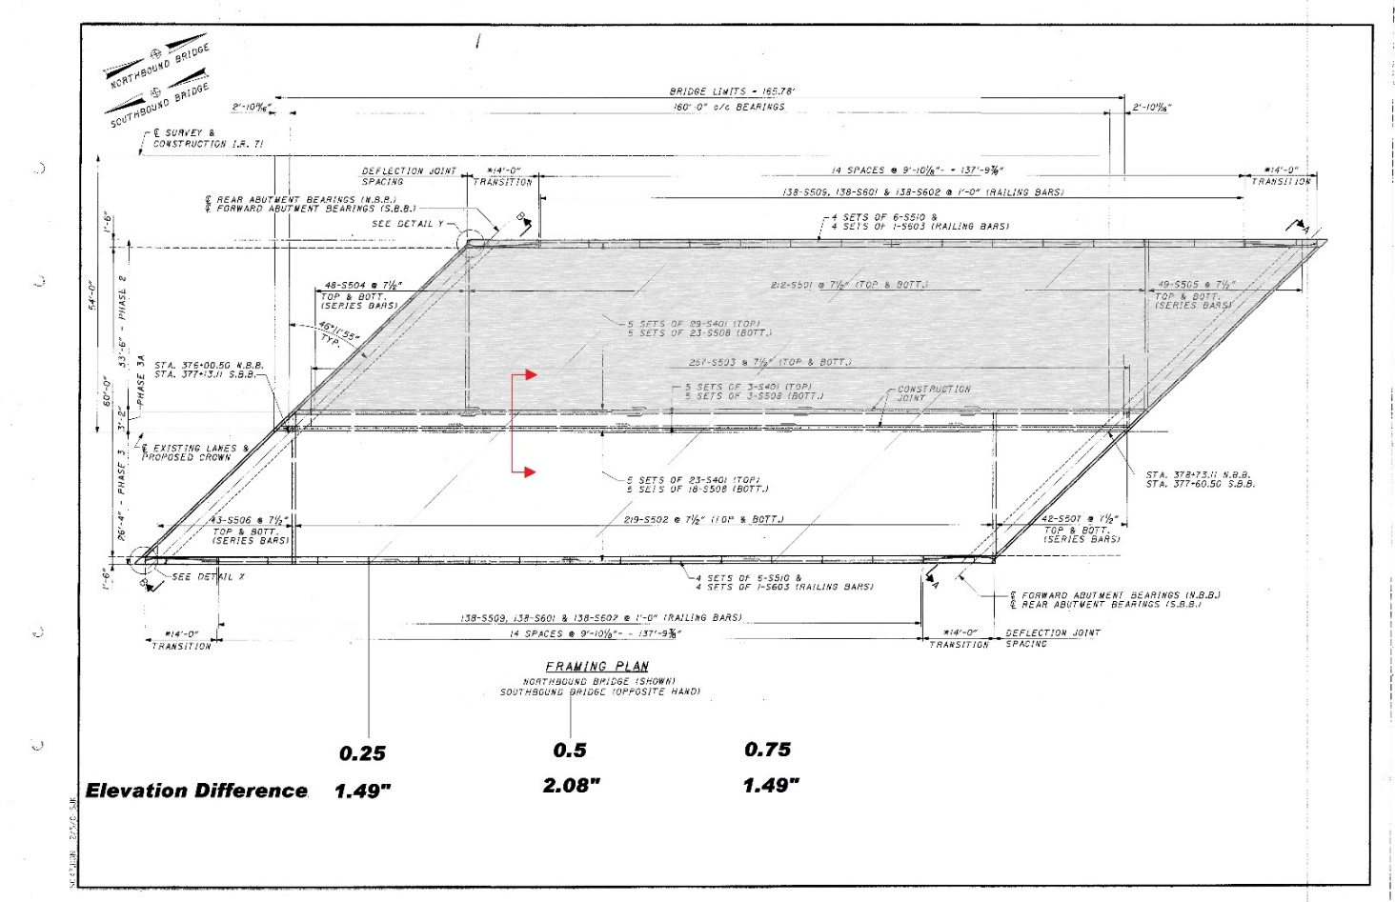
Alignment of Reinforcing Steel

Slide 8
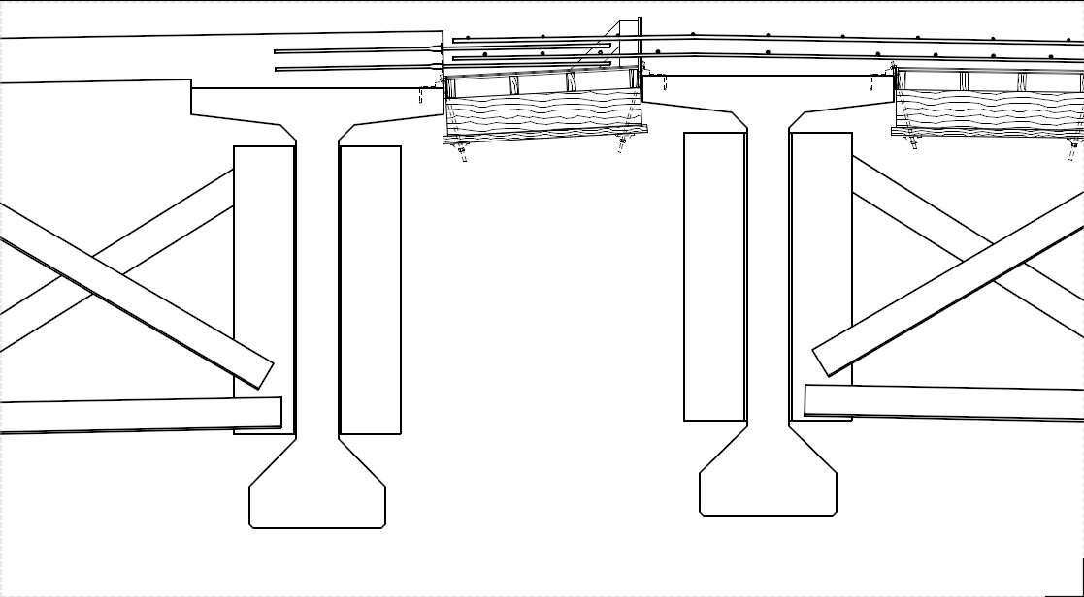
Alignment of Reinforcing Steel

Slide 9
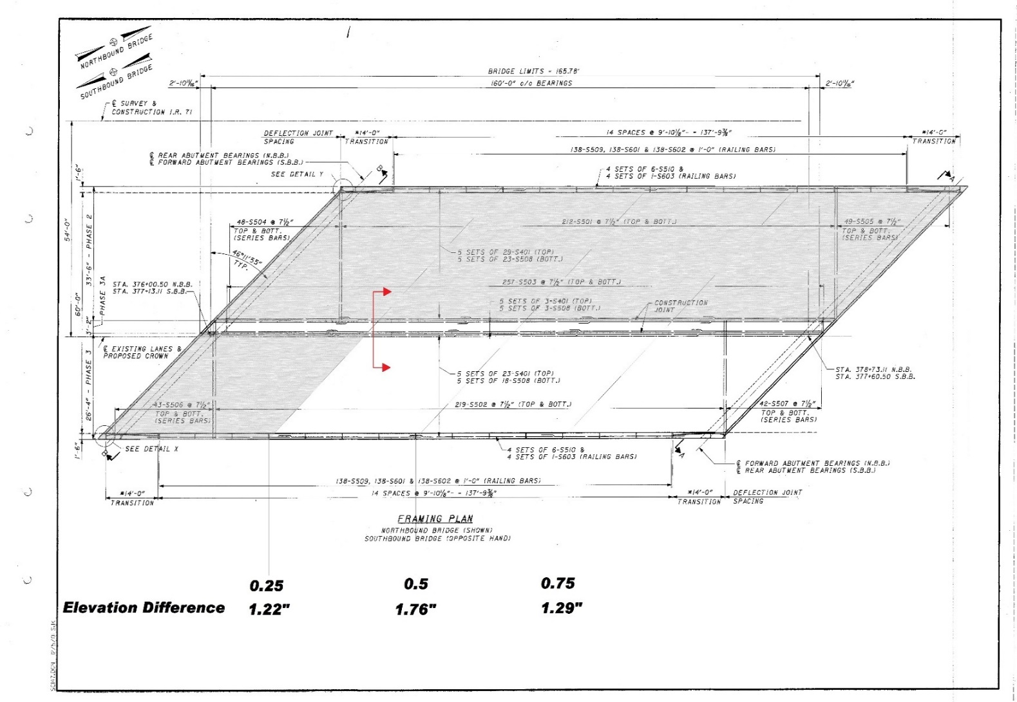
Alignment of Reinforcing Steel

Slide 10
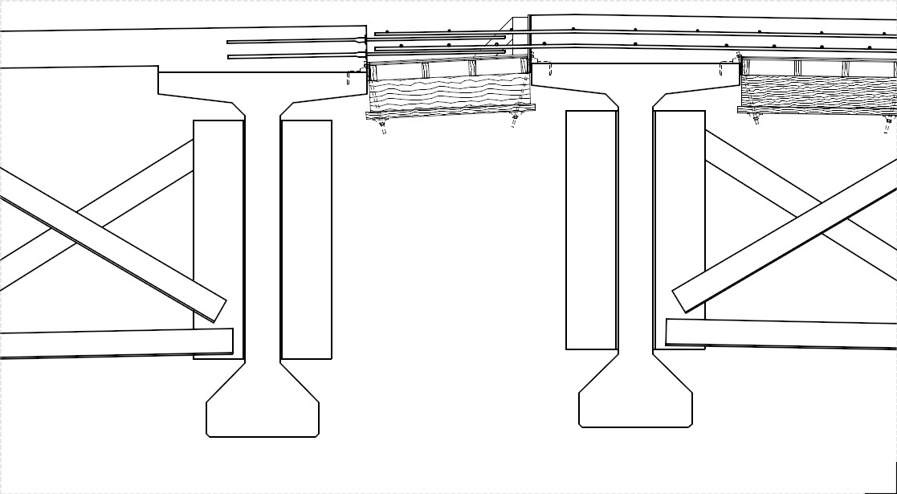
Alignment of Reinforcing Steel

Slide 11
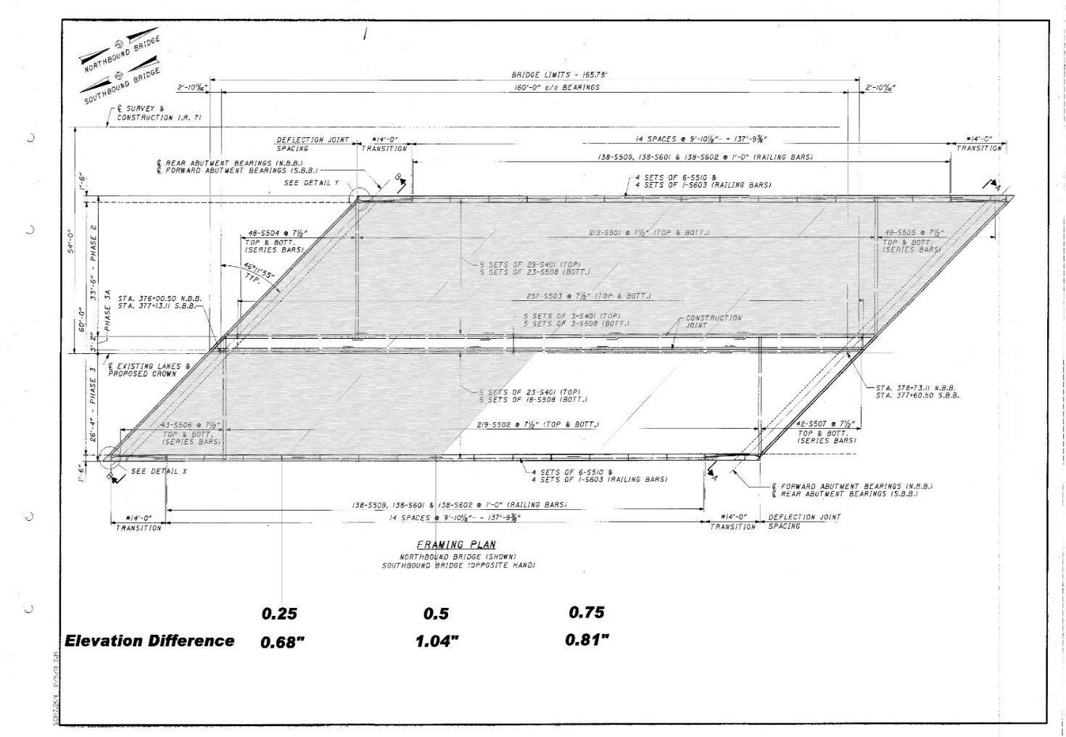
Alignment of Reinforcing Steel

Slide 12
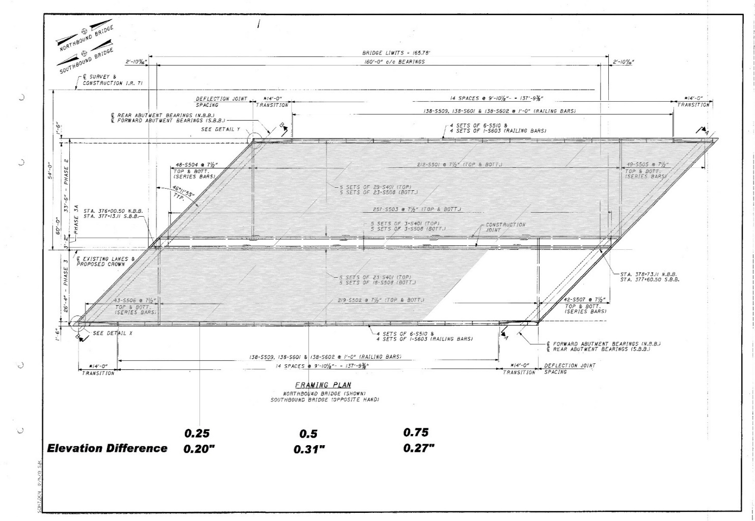
Alignment of Reinforcing Steel

Slide 13
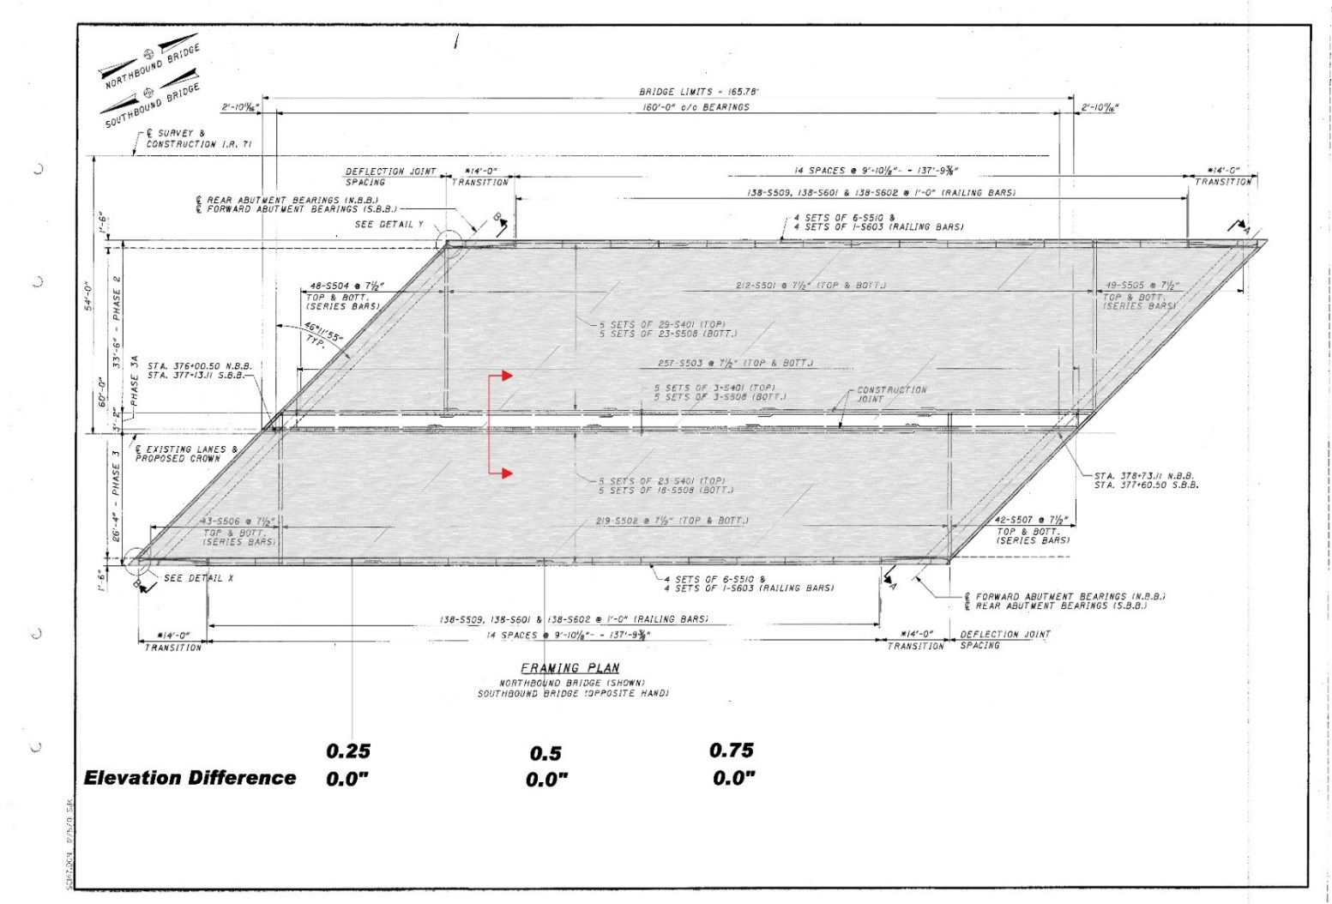
Alignment of Reinforcing Steel

Slide 14
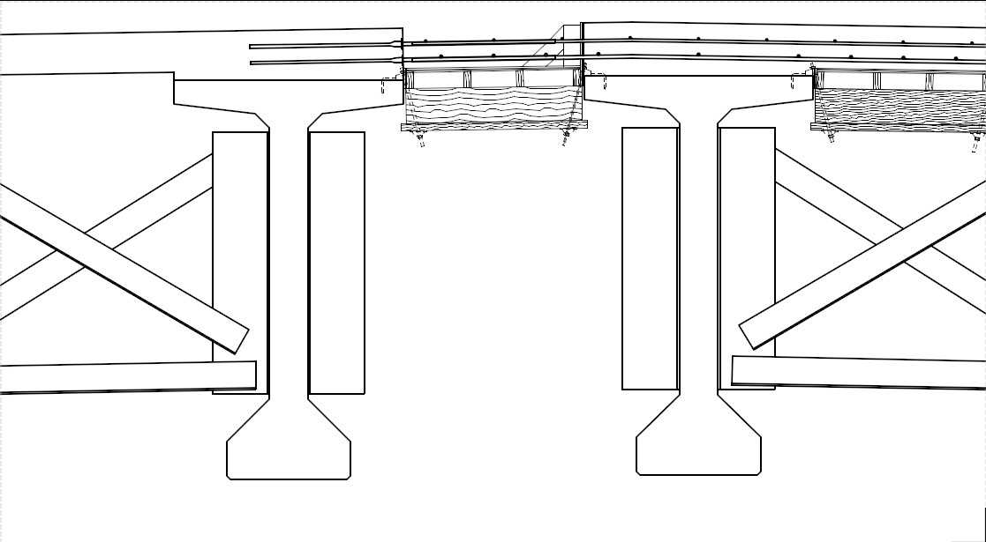
Alignment of Reinforcing Steel

Slide 15
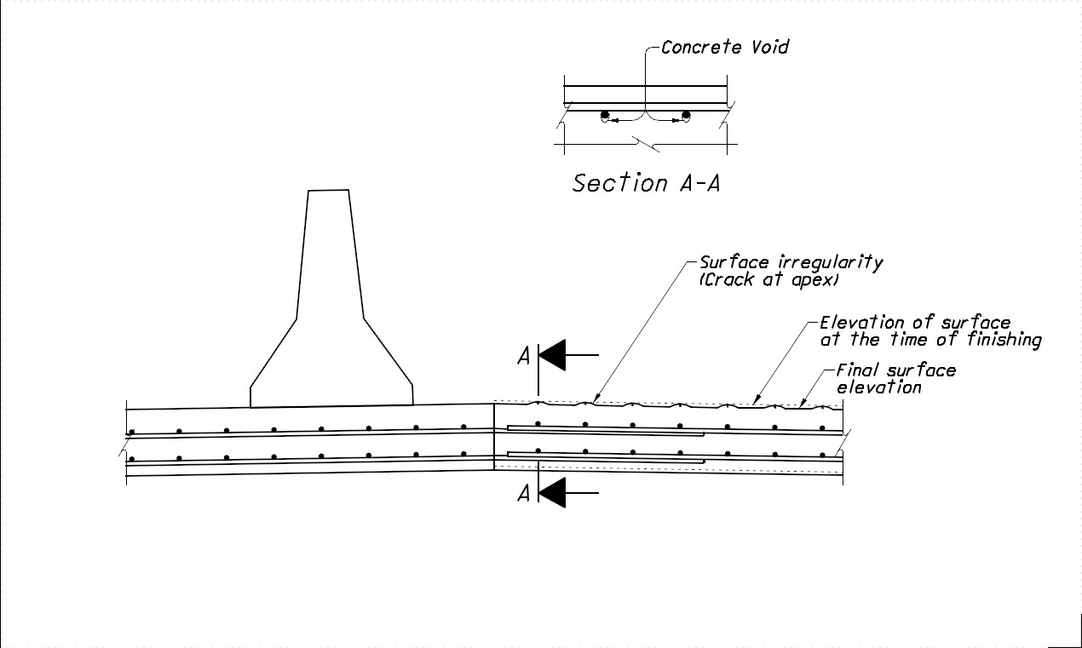
Voids & Surface Irregularities

Slide 16
Voids & Surface Irregularities
“…differential deflection equal to or greater than 0.05 inches caused a reduction in the bond strength (of the reinforced connection)” – FHWA Publication No.: FHWA-HRT-12-055

Slide 17
Slab Superstructures
Two primary sources of deflection:
  Δ₁ = Deflection of the falsework due to its selfweight, wet weight of the slab concrete and weight of the slab reinforcement. The determination of each of these sources of deflection depends upon the Contractor’s falsework design
  Δ₂ = Deflection of the slab due to its selfweight when the falsework is removed

Slide 18
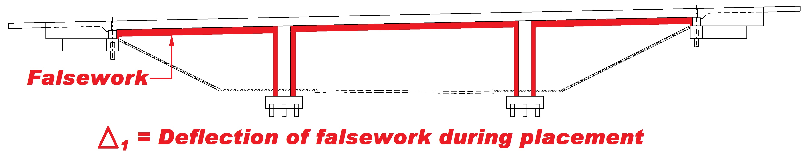
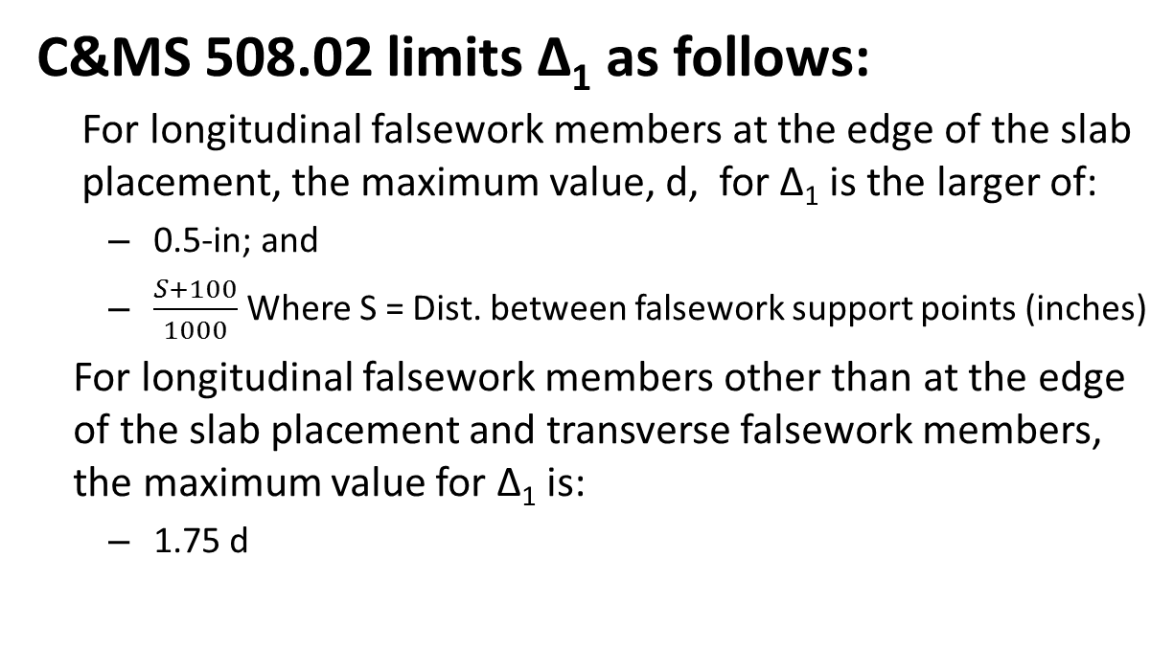
Slab Superstructures
C&MS 508.02 limits Δ₁ as follows:
For longitudinal falsework members at the edge of the slab placement, the maximum value, d, for Δ₁ is the larger of:
  0.5-in; and
  $\frac{S+100}{1000}$ Where S = Dist. between falsework support points (inches)
For longitudinal falsework members other than at the edge of the slab placement and transverse falsework members, the maximum value for Δ₁ is:
  1.75 d

Slide 19
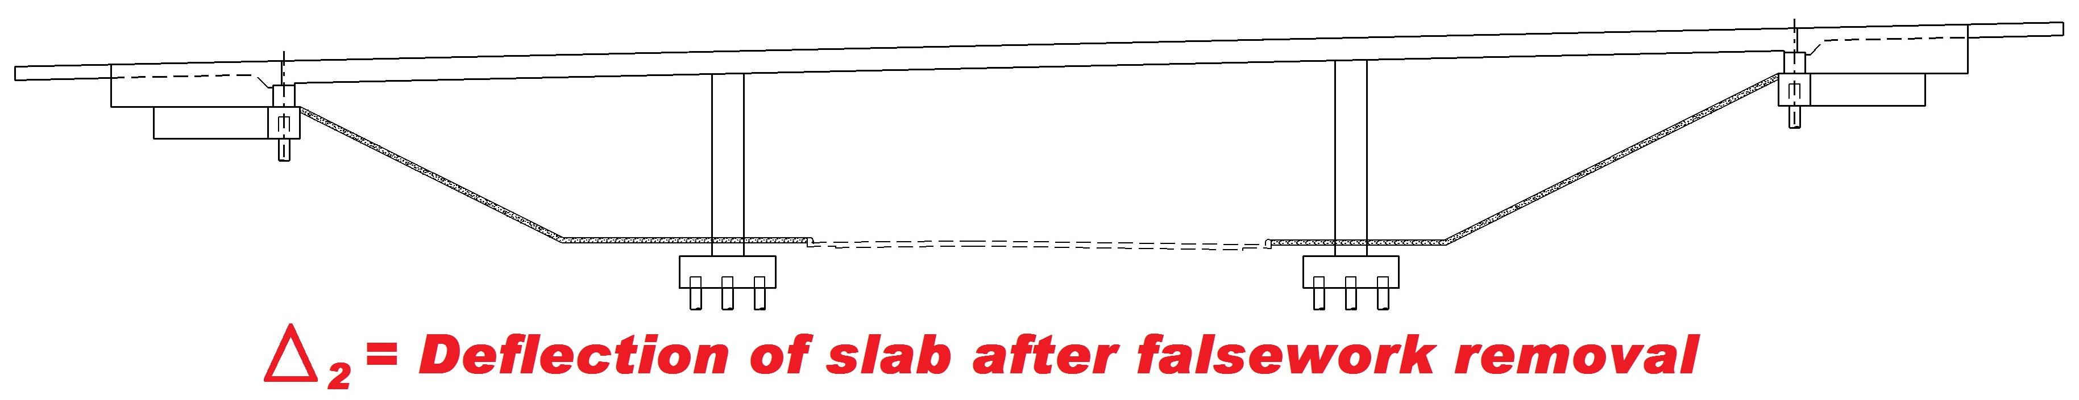
Slab Superstructures
C&MS 508.02 provides deflection values for Δ₂ with respect to the slab span (S) as follows:
  For continuous span slabs, Δ₂ = S/800
  For simple span slabs, Δ₂ = 0.000018 S³

Slide 20
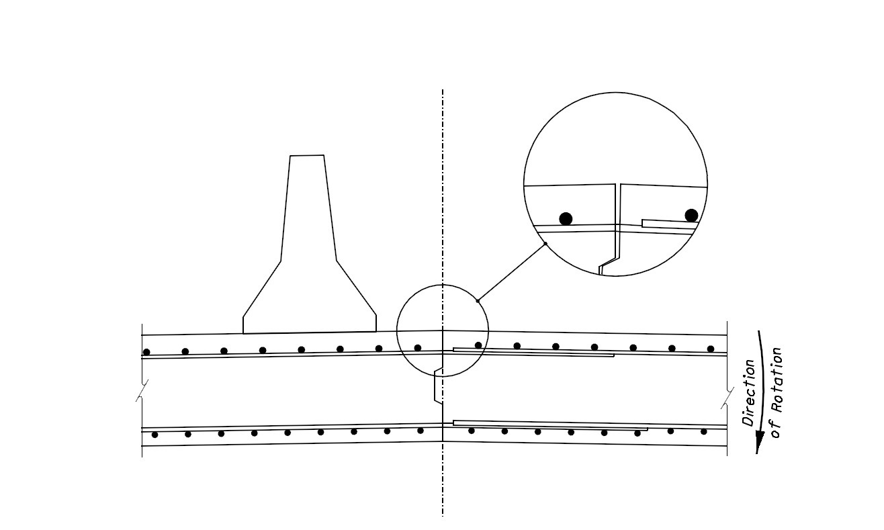
Opening of Construction Joints
Without Closure Pour, the Construction Joint can open when the falsework is removed.

Slide 21
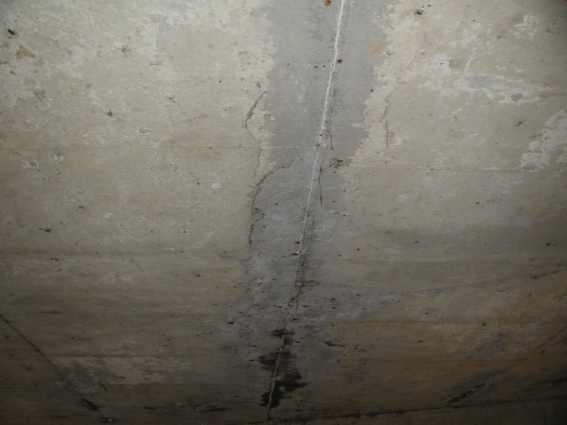
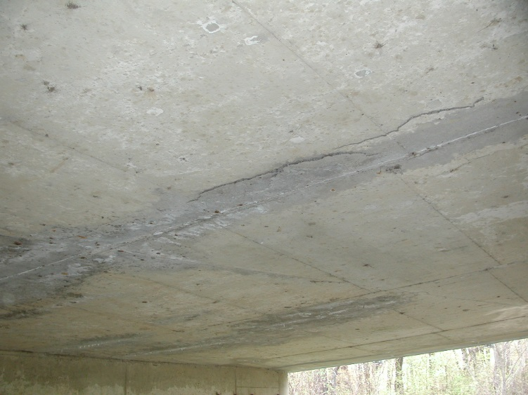
Opening of Construction Joints

Slide 22
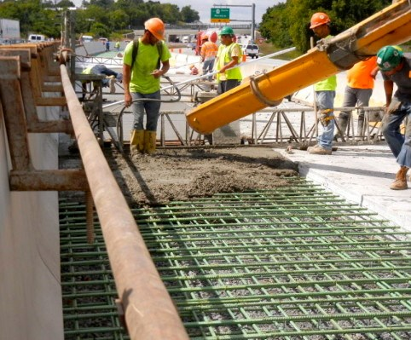
Questions?

Slide 23
Thank You!

